Slide 1

Analyzing Loan Default Risk Factors –Lending Club
Insights from Exploratory Data Analysis
Rajesh Rao and Akshit
07-Nov-2023

Slide 2
Data Analysis Presentation
Introduction
Overview and purpose of the data analysis
Data Overview
High-level summary of the key variables and metrics in the dataset
Data Preparation
Steps taken to clean, transform, and prepare the data for analysis
Univariate Analysis
Key insights from analyzing the distribution of individual variables
Segmented Analysis
Findings from analyzing key metrics segmented by various attributes
Bivariate Analysis
Results of analyzing relationships between pairs of variables
Insights and Recommendations
Suggested actions based on the key insights from the analysis

Slide 3


Data Overview
Dataset has over 39,000 loan records
Objective: "The goal is to identify patterns and factors contributing to loan defaults, marked as 'Charged Off' in our dataset.
The records are from 2007 to 2011 and detail borrowers' backgrounds, loan details, and repayment status.
This dataset will allow us to analyze patterns and factors associated with loan defaults to build a predictive model.

Slide 4



Data Preparation
Imported data into Pandas
Cleaned the data
Transformed the data
Utilized Pandas for efficient data importation and preliminary analysis
Removed columns with missing values and redundant fields to improve data quality
Standardized date fields and converted data to numeric format for analysis
Performed statistical summaries to grasp data attributes.
Omitted columns with over 95% missing values to ensure data quality.
Standardized date fields for e.g issue_d and earliest_cr_line for temporal analysis.
Excluded columns with predominant zeros, reducing noise.
Stripped non-numeric symbols from fields and converted to numeric for uniformity.
Removed transaction-specific and redundant fields irrelevant to the study
The data was successfully imported, cleaned and transformed for further analysis

Slide 5
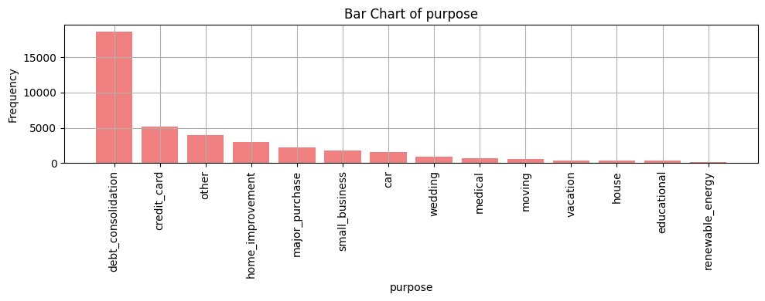
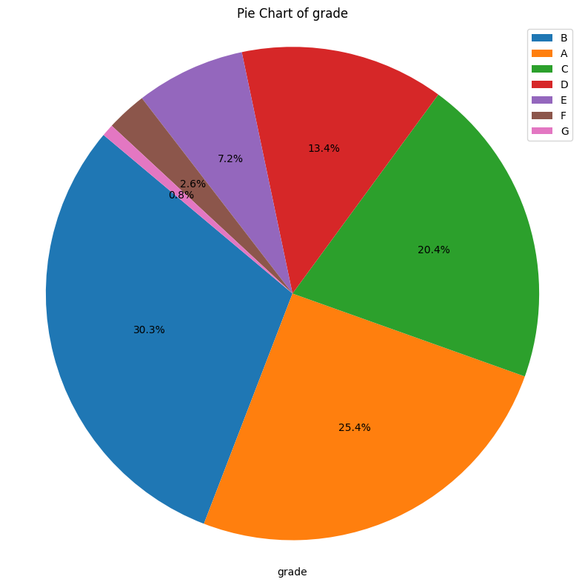
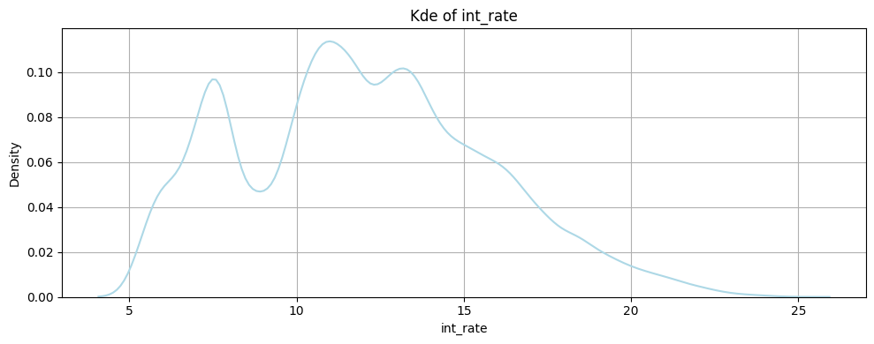
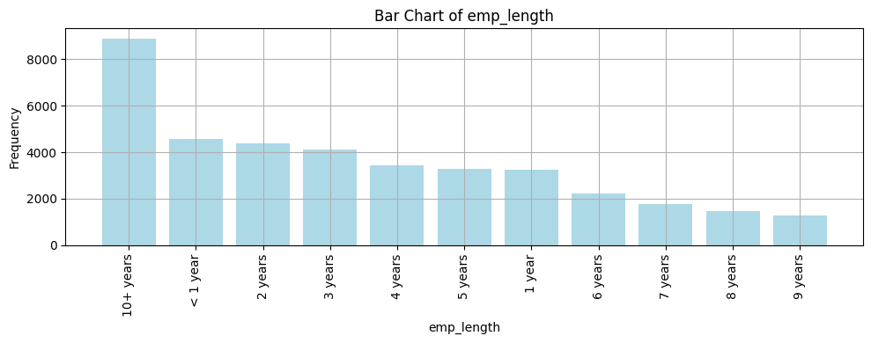
Univariate Analysis
Nearly 75% of loans are provided to A,B,C grades
Majority of borrowers want to consolidate debt
Majority of borrowers have more than 10 year work experience
Majority of loans have interest rates between 10-15%

Slide 6
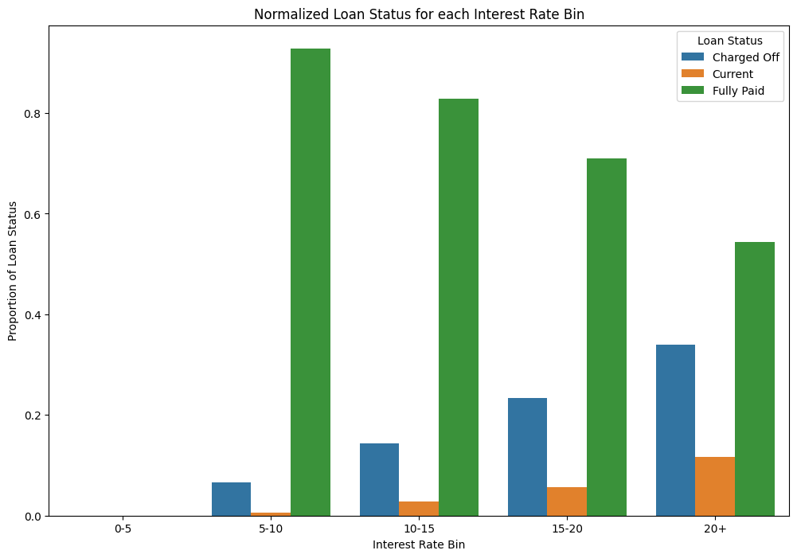
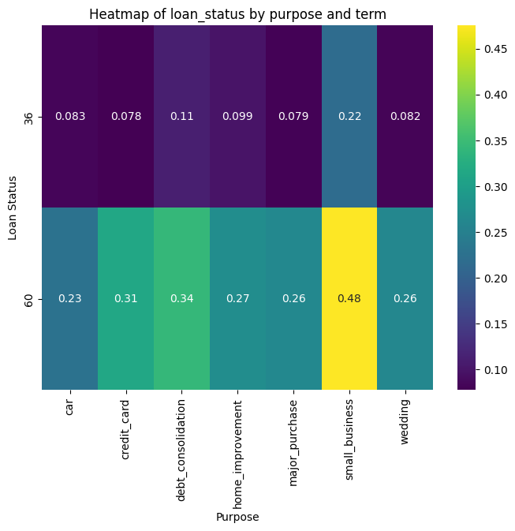
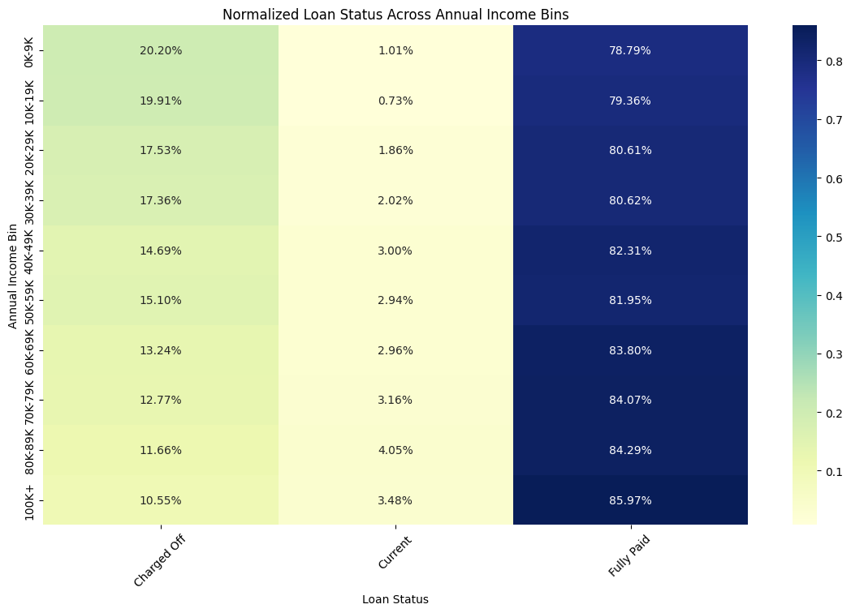
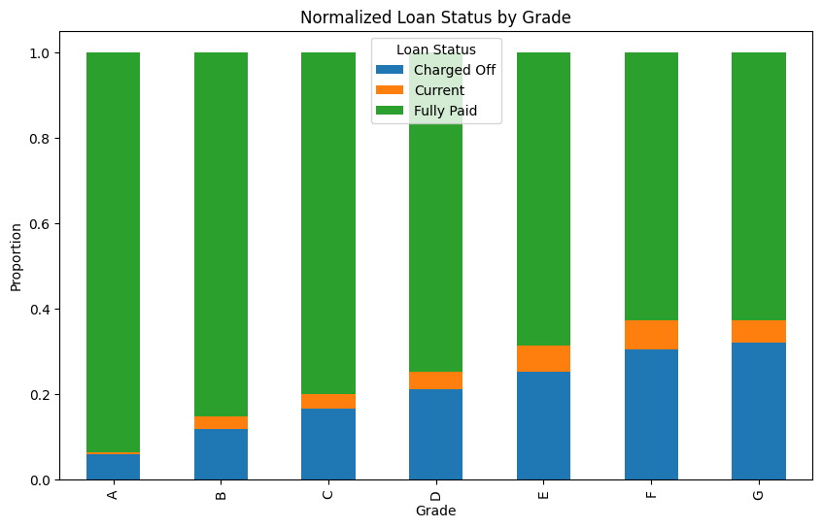
Segmented Univariate Analysis
Higher interest rate has higher charge-offs
Small business loans have higher charge offs
Lower grades E,F, G have higher charge-off rates
Lower-income have higher charge offs

Slide 7
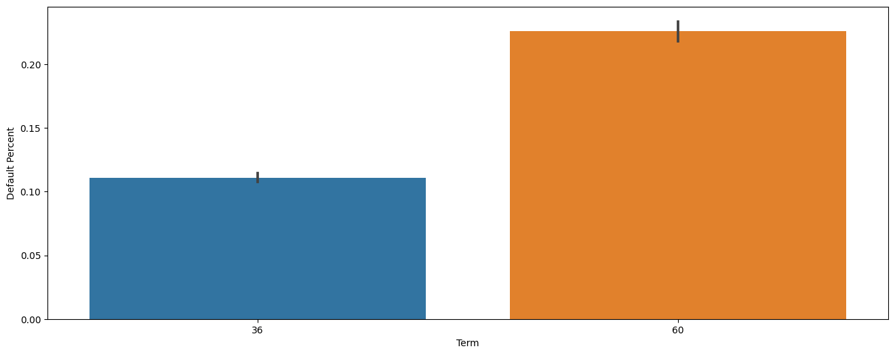
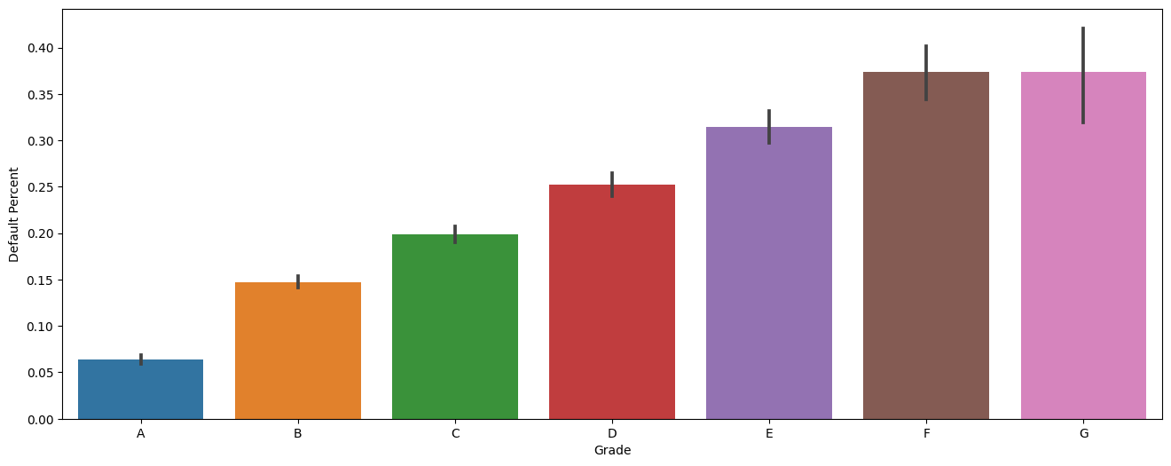
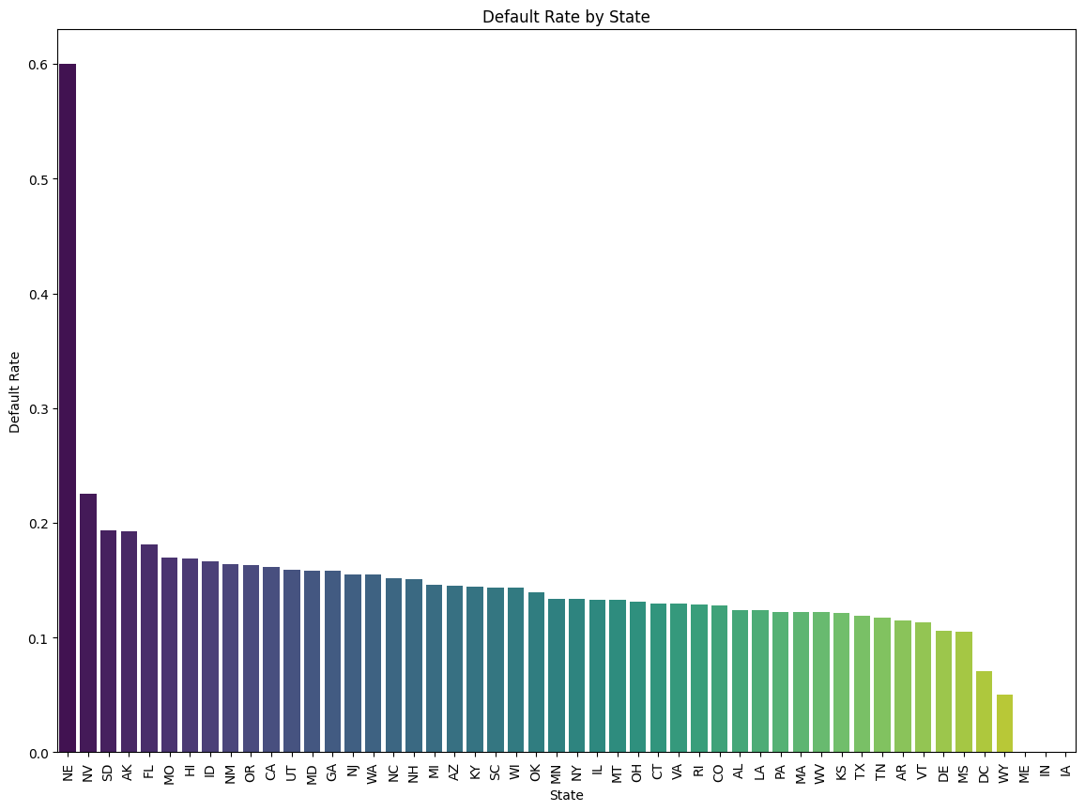
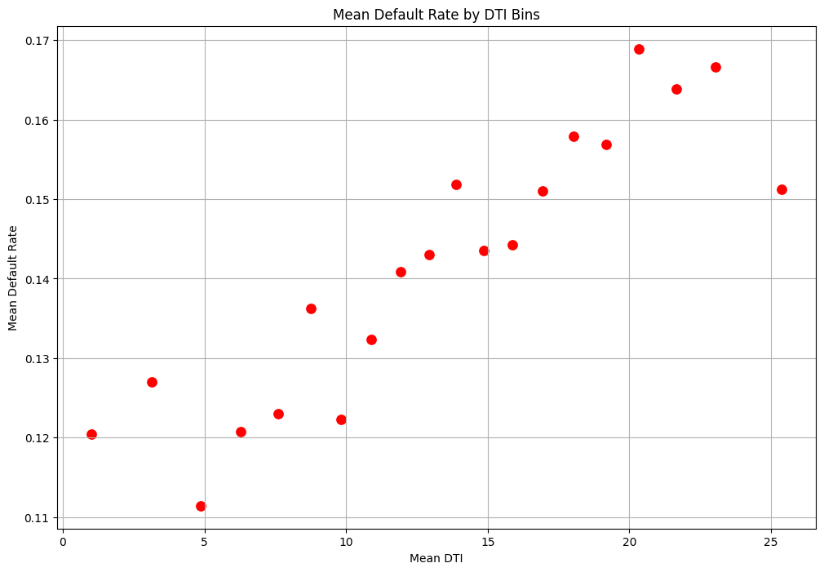
Bivariate Analysis
60-month term exhibits more charge-off than 36-month term
Lower grades E,F, G have higher charge-off rates
Certain stages like NE, NV have significantly higher charge-off
Higher debt to income ration(DTI) leads to higher charge-offs

Slide 8
Key Findings
High default rates for small business loans
Due to variable success of small businesses
60-month loans originated in 2010-11 have higher defaults
Possibly due to economic conditions or longer repayment period
Higher loan amounts correlate with higher defaults
Increased repayment burden if finances change
Customers with high debt-to-income ratio default more
High DTI indicates financial strain
Lower income customers have higher defaults
Limited finances make repayment challenging
Lower credit grades have higher defaults
Indicate lower creditworthiness

Slide 9



Managing Lending Risk Recommendations
Higher risk loans
Lower credit grades
Longer loan terms and State Specific Strategies
Implement stricter lending criteria and higher interest rates for higher risk loans like small business loans or loans with high DTIs or low income borrowers.
Require co-signers and charge higher risk premiums for borrowers with lower credit grades and higher DTIs
Introduce early intervention strategies and graduated risk assessments for longer 60+ month loans. Develop state-specific strategies to combat charge offs
By tailoring lending practices to specific risk factors, banks can expand lending to higher risk groups while still managing overall credit risk.

